Slide 1
USH Unit 6
American Expansionism and WWI
https://www.youtube.com/watch?v=BShvYeyMm_Y

Slide 2
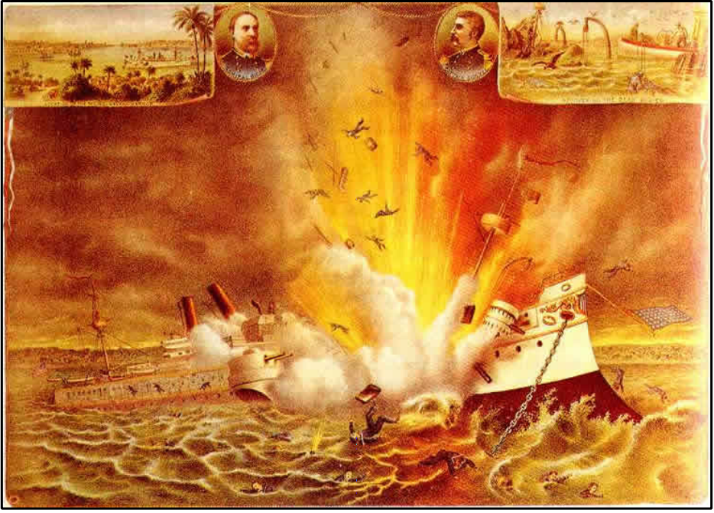
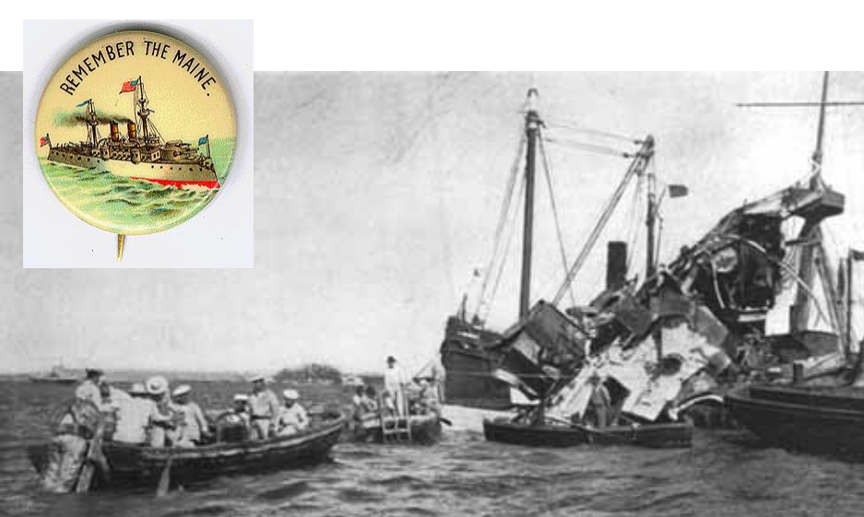
The Spanish-American War
Sinking of the USS Maine – U.S. battleship explodes while sitting in the harbor of Habana, Cuba. U.S. blames Spain. – April 1898 U.S. declares war on Spain.
Yellow Journalism - exaggerating or stretching the truth.
“Remember the Maine”

Slide 3
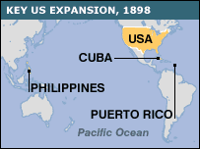
Results of the Spanish-American War
The US defeats Spain
U.S. gets Puerto Rico, Guam, Cuba, and the Philippines
U.S. pays Spain $20 million – As a result of the Sp-Am War: • U.S. now owns an empire
Ends U.S. isolationism
U.S. emerges as a world power

Slide 4
American Expansionism (Imperialism)
Many were concerned about America’s expansionism and continued involvement in Latin America. (Remember Washington warned Americans to stay out of foreign affairs in his Farewell Speech)
• Philippine-American War – After Sp-Am War, Filipinos were angry that the U.S. simply replaced the Spanish as a controlling power –
Emilio Aguinaldo led a revolt against U.S. forces in 1899.

Slide 5
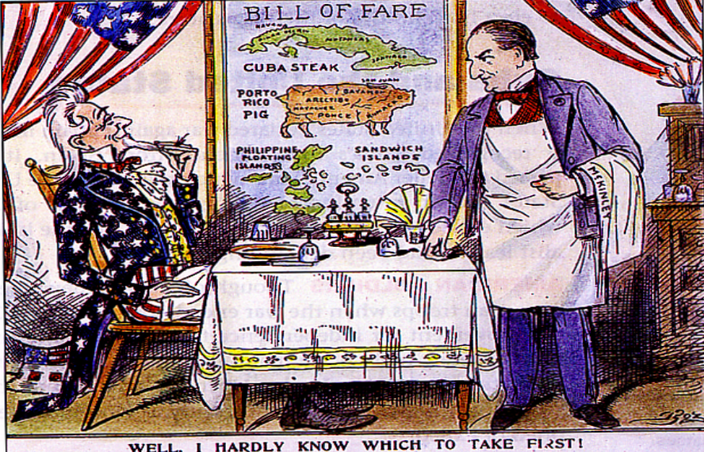

Slide 6
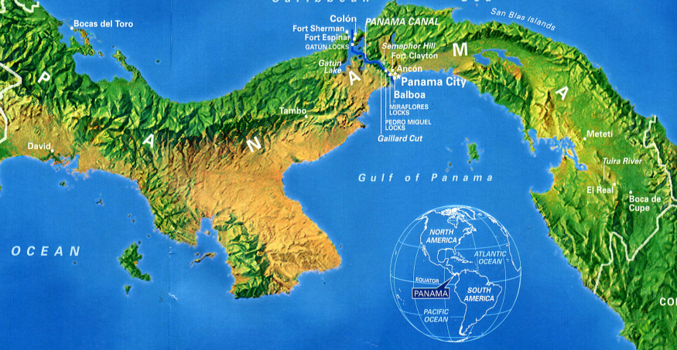
American Expansionism in Latin America
Panama Canal - A canal built by the U.S. cutting across Central America to reduce travel time and provide a short cut between the oceans for commercial and military ships.
– U.S. chose Panama for the canal, which belonged to Colombia. They refused our offer…wanted more $.
– US helps Panama rebel against Colombia – Panama accepts our offer ($10m and $250,000 a year)
– Canal built between 1904-1914
Strategic politically and militarily

Slide 7
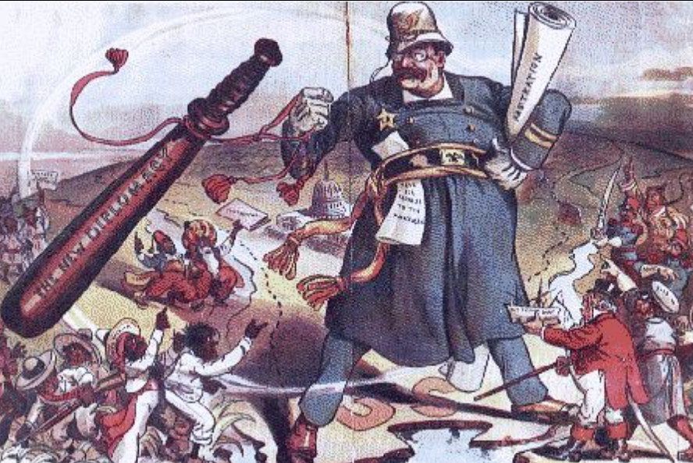
American Expansionism: Roosevelt Corollary to the Monroe Doctrine
Roosevelt Corollary – European powers were getting involved in Latin America
– TR wanted US to be the most powerful influence in Latin Am. – “Speak softly and carry a big stick”
– The Roosevelt Corollary stated: the U.S. would use force to protect its economic interests in Latin America

Slide 8
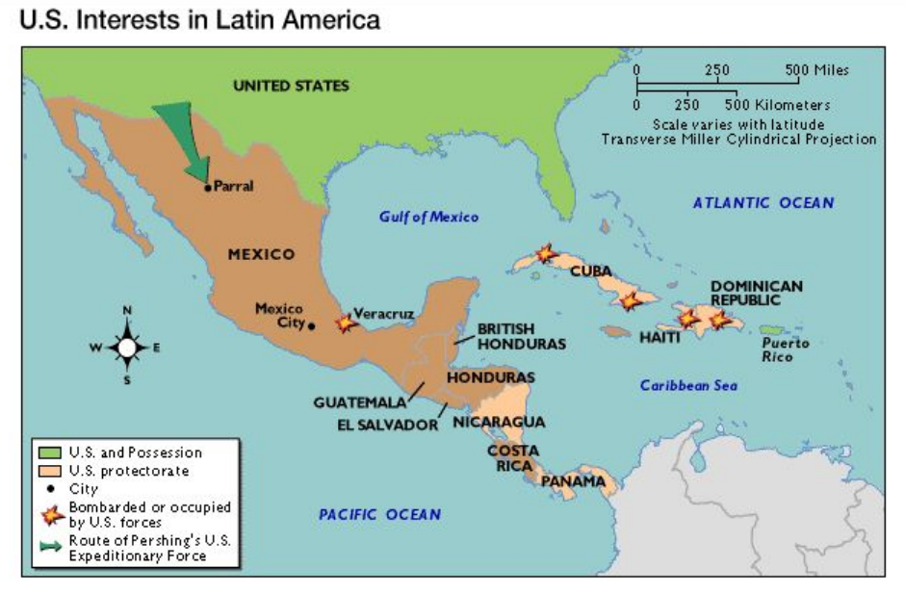

Slide 9
American Expansionism leads us into a new era. America on the world stage.

Slide 10
America on the world stage https://www.youtube.com/watch?v=eVwrdEQZOnw

Slide 12
Add a Slide Title - 5
https://www.youtube.com/watch?v=dzaMP5ZXryU

Slide 14
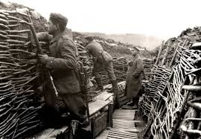
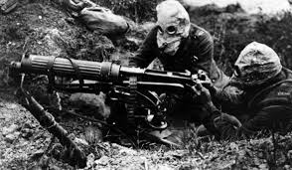
Why Does The US Enter The Great War?
https://www.youtube.com/watch?v=g34CHh7KeFA
(add important points from the video clip to your notes)

Slide 15
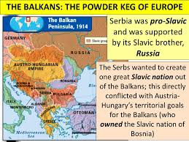
Causes of the War in Europe
*Europe is like a “powder keg”
Militarism
Alliance System
Nationalism
Imperialism
Assassination

Slide 16
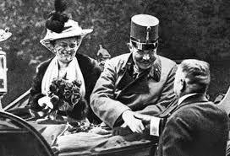
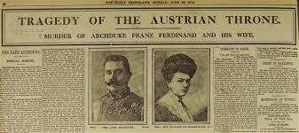
The Spark That Started The War
The Assassination of the Austrian Archduke Ferdinand by a Serbian nationalist, Gavrilo Princip

Slide 17
Domestic Impact of WWI

Slide 19
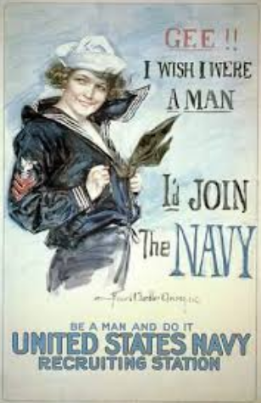
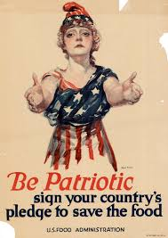
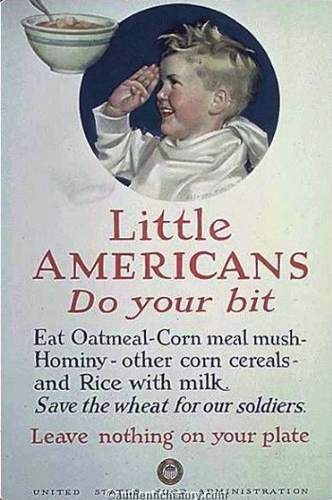
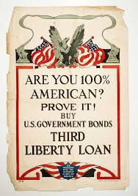
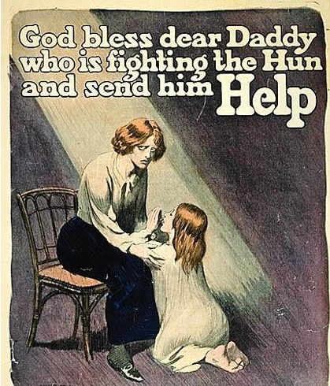
Domestic Impacts of WWI
Propaganda
Information meant to persuade or sway the public
Posters, Pictures, Parades, Songs
Emotional Appeal

Slide 20
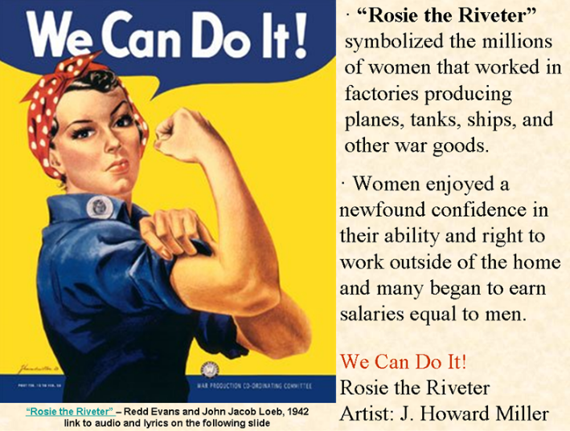
Domestic Impact of WWI: Rosie the Riveter
https://www.youtube.com/watch?v=04VNBM1PqR8

Slide 22
Wilson’s Plan for Peace: The 14 Points
https://www.youtube.com/watch?v=GwKl8PEl-fs

