Slide 1
SSUSH 18 The student will describe Franklin Roosevelt’s New Deal as a response to the depression and compare the ways governmental programs aided those in need.
A. Describe the creation of the Tennessee Valley Authority as a works program and as an effort to control the environment

Slide 2
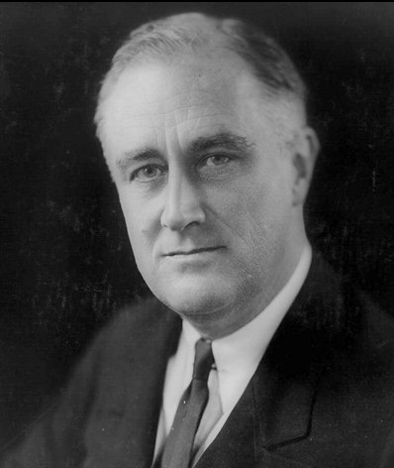
Election of 1932
Franklin Delano Roosevelt: Democratic nominee
Progressive leader
Gov. of New York
Emphasis on
relief programs

Slide 3
The New Deal
FDR’s plan for ending the Depression
Focused on 3 R’s:
- Relief of citizens problems
- Recovery of economy
- Reform society

Slide 4
The Programs
Known as alphabet soup
Goal: address Three R’s
FDR successful beginning programs in 1st 100 days

Slide 5
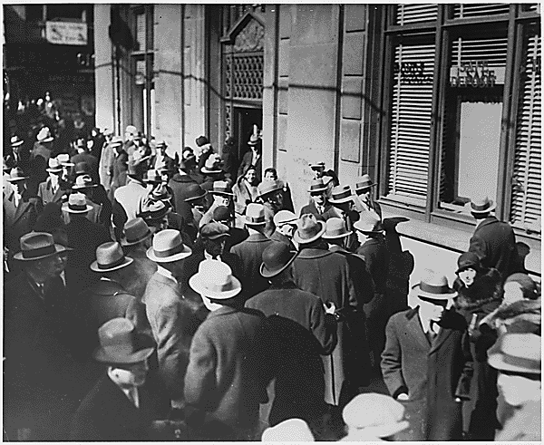
Emergency Banking Act establishes
“Federal Deposit Insurance Corporation”

Slide 6
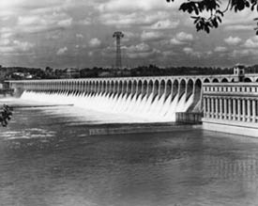
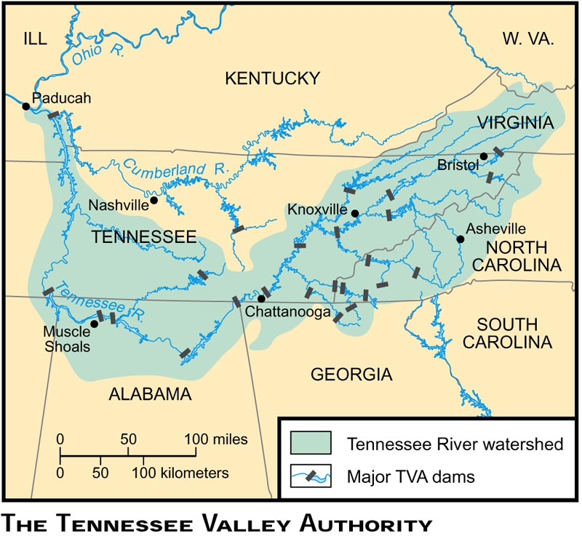
TVA: Tennessee Valley Administration

Slide 7
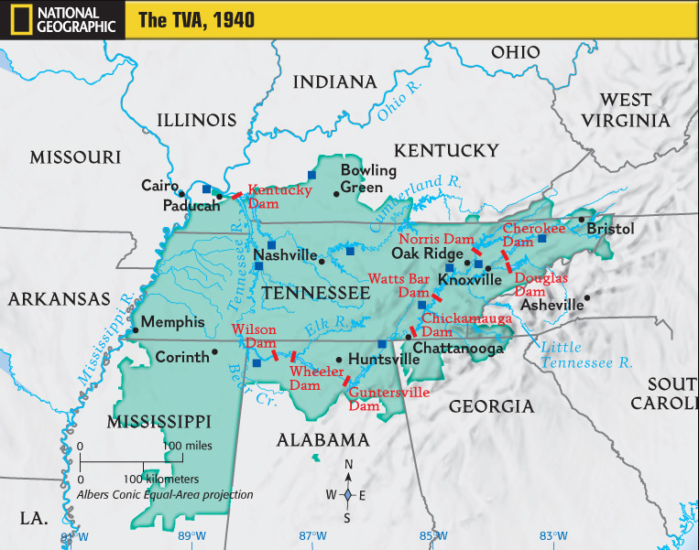
TVA
In 1933 the Tennessee Valley Authority (TVA) was created as part of Roosevelt’s New Deal to control floods and bring electricity to rural America
The TVA generated over 40,000 jobs building dams, power plants, roads and miles of wiring
What do workers do with
the money they earn?
How could the TVA help
the economy?

Slide 8
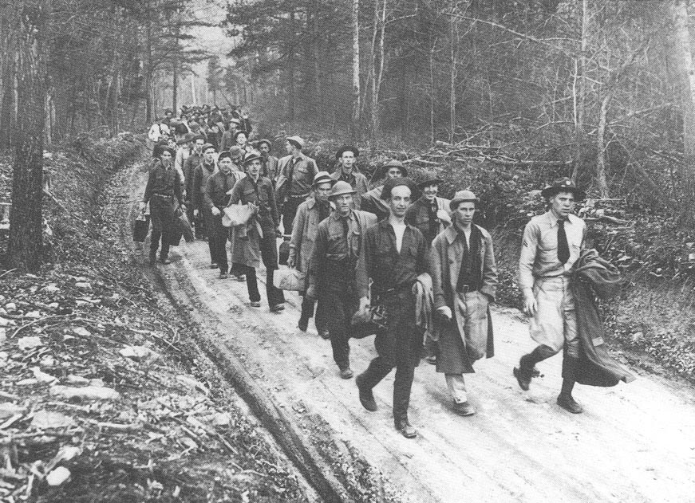
CCC: Civilian Conservation Corps:
Created jobs in road-building & conservation projects to reduce unemployment

Slide 9
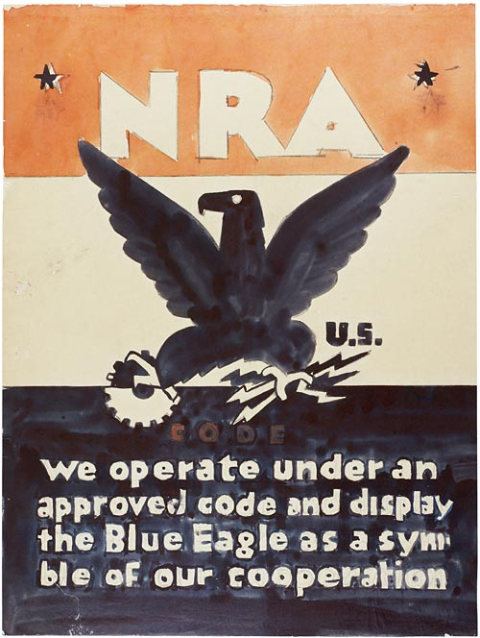
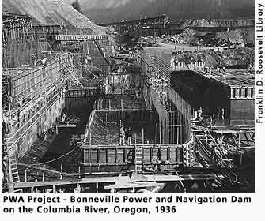
NRA: National Recovery Administration set prices and est. codes of fair practice for industries
PWA: Public Works Administration:
Provided $ to states to create jobs building schools and community buildings & reduce unemployment

Slide 10
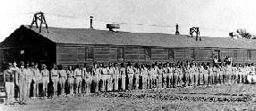
Civil Works Administration: created 4 million jobs in effort to reduce unemployment

Slide 11
SSUSH 18 The student will describe Franklin Roosevelt’s New Deal as a response to the depression and compare the ways governmental programs aided those in need.
B. Explain the Wagner Act and the rise of industrial unionism

Slide 12
Wagner Act
The National Labor Relations Board of the Wagner Act of 1935 was created by Congress to protect workers' right to unionization.
Guarantees employees the right to self-organize, choose their own representatives, and bargain collectively
Encourages collective bargaining as a means of maintaining industrial peace.

Slide 13
SSUSH 18 The student will describe Franklin Roosevelt’s New Deal as a response to the depression and compare the ways governmental programs aided those in need.
C. Explain the passage of the Social Security Act as a part of the second New Deal

Slide 14
Second New Deal
Surge in New Deal programs
-- popular, yet, somewhat ineffective
1934 midterm elections Democrats
Many of 1st New Deal programs ruled unconstitutional (b/c federal government deemed to have overstepped its authority)
Led to “court packing” bill: attempt by FDR to increase # of justices on SC

Slide 15
2nd New Deal Programs
Works Progress Administration
-- Employment in public works; building airports, repairing
roads
-- spent $ 11 billion & employed 8 million workers
National Labor Relations Act
- commonly called “Wagner Act”
- Recognized Labor right to organize &
bargain

Slide 16
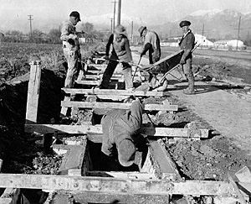
Works Progress Administration

Slide 17
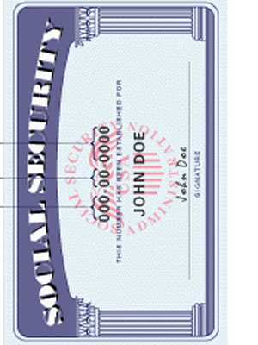
Social Security Act: 1935
3 parts:
1) old-age insurance for retirees &
spouses
2) unemployment compensation
3) aid to families with children & the
disabled
Funded by workers and employers, and federal funds made available to states

