Slide 1
Cultures Clash on the Prairie
When: after the Civil War
Where: The Prairie States- land between Mississippi River and Rocky Mountains
(States: Kansas, Nebraska, Iowa, Minnesota, South Dakota, North Dakota, Wyoming, Montana)

Slide 2
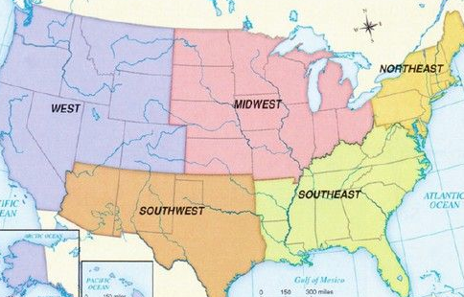

Slide 3
What cultures clash?
1) White Settlers
2) Native Americans
3) Immigrants

Slide 4
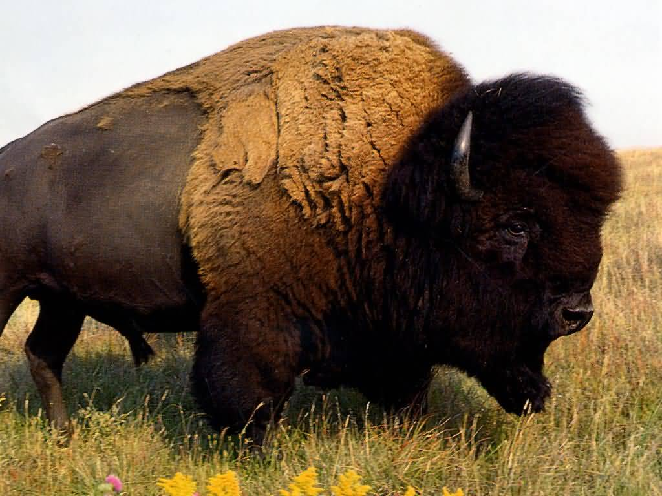
Native Americans
Relied on Buffalo to survive
Used all parts of the buffalo: skins, hides, bones, meat, hooves, horns….
Whites kill the buffalo for fun
Push the buffalo to near extinction
DESTROY Indian way of life

Slide 5
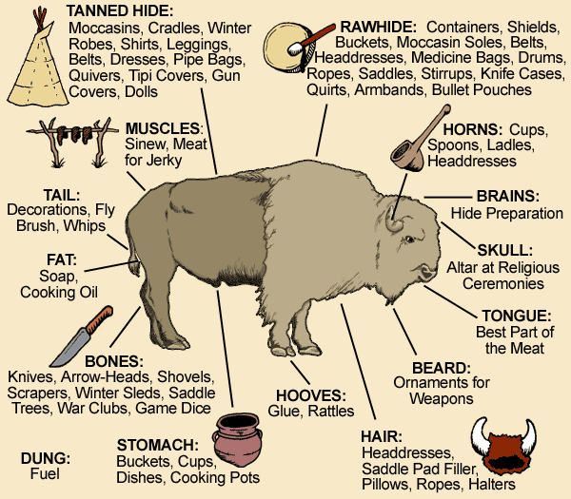

Slide 6
Native Americans
Moved around following buffalo
Problem:
Whites own land, settle permanently, want to farm the prairies and herd cattle
Whites want Indians to live on reservations: gov would give allotted land where all tribes would live together

Slide 7
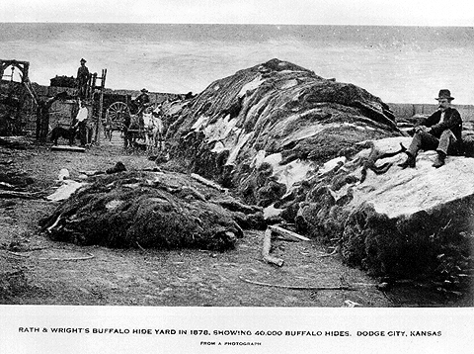
Buffalo

Slide 8
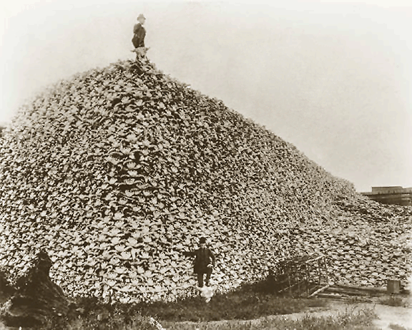

Slide 9
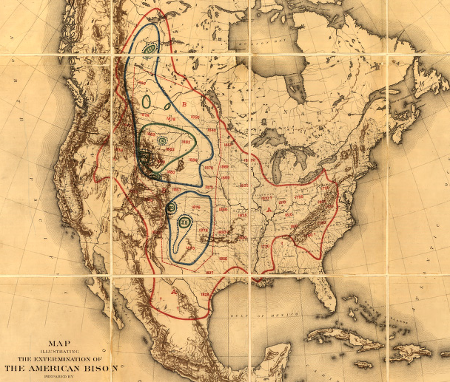
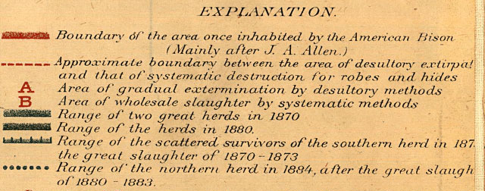

Slide 10
Conflict!
Whites want the land the Native Americans control
Broken Treaties → US signed many treaties with Native Americans to force them to settle in one place, but kept breaking them by invading
Often, violence and war erupted over land
Government forces Native Americans to live on reservations
Notes:
http://www.history.com/topics/battle-of-the-little-bighorn/videos#american-buffalo

Slide 11
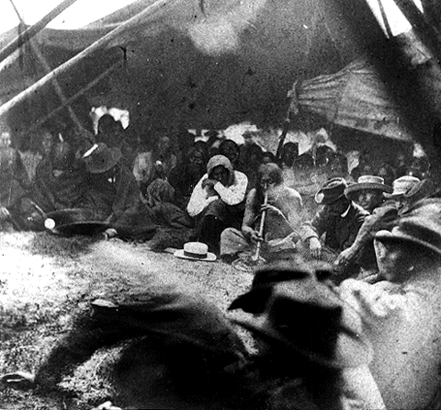
Native Americans

Slide 12
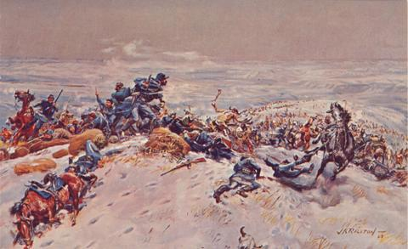
Capt. William J. Fetterman

Slide 13
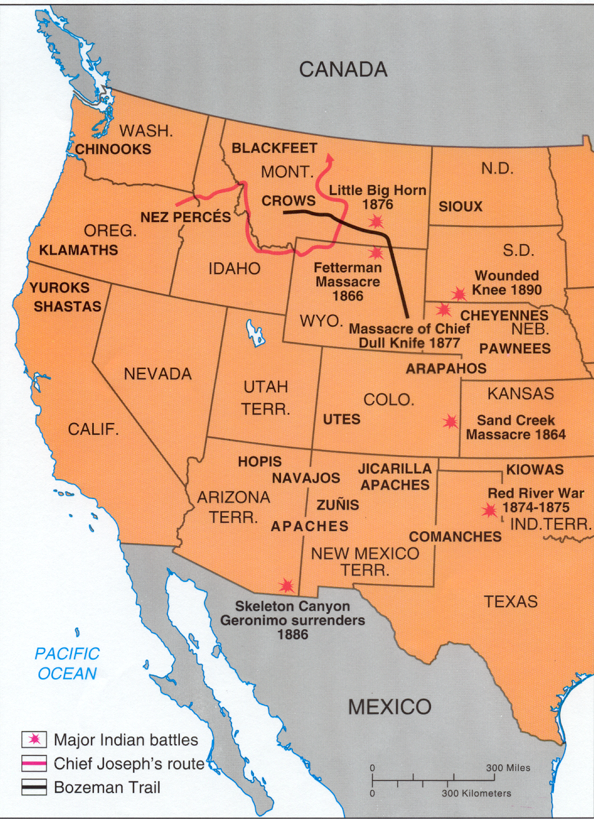
2nd Treaty of Ft. Laramie (1868)
Aka Sioux Treaty
Black Hills = sacred to Sioux
But… gold is discovered in the Black Hills → miners go and demand US gov’t protection
ULTIMATELY in 1877 US confiscates the land, and it’s still under dispute

Slide 14
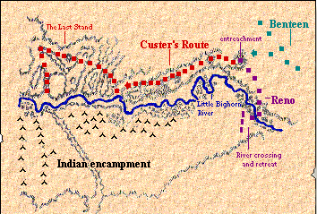
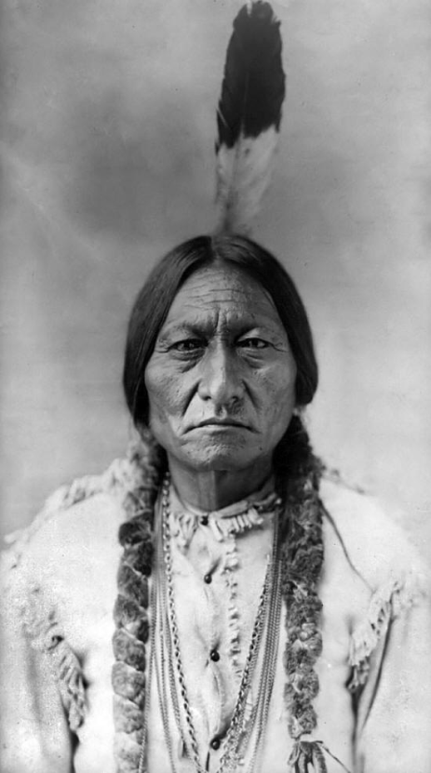
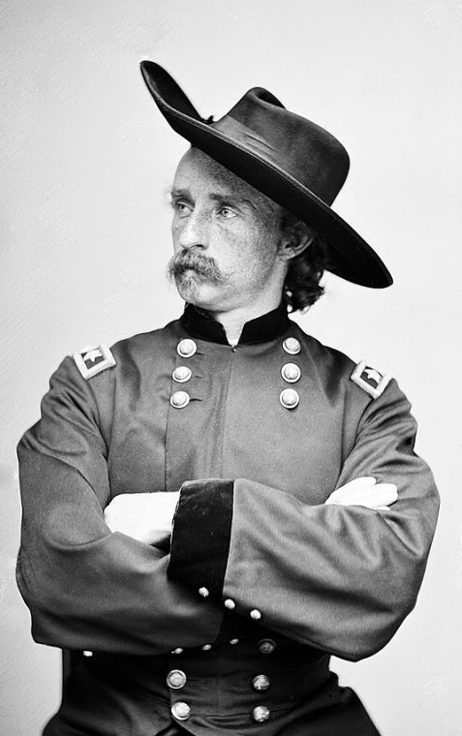
Chief Sitting Bull
General George Custer

Slide 15
Battle of Little Big Horn (1876)
Battle of Little Bighorn
Native Americans defeat US Army led by Custer
Native American tribes led by Sitting Bull and Crazy Horse
Custer’s Last Stand
Custer was looking for a fight, Native Americans surround him and kill him and his troops
Notes:
http://www.history.com/topics/battle-of-the-little-bighorn/videos#american-buffalo

Slide 16
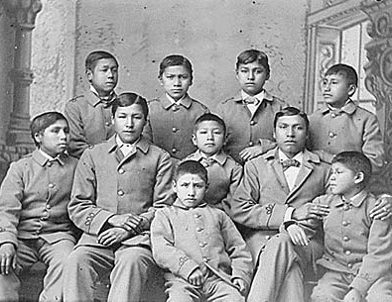
Dawes Act (1887)
Native Americans forced to live on 160 acres of land; divide tribal land into individual plots
Goal: assimilate & Americanize (live like whites)
Carlisle Indian School, PA

Slide 17
The Failure of Reform
Many Americans criticized the treatment of the Native Americans
Dawes Act in 1887 – tried to turn Native Americans into farmers by giving them land and setting up schools
It failed
Most natives sold their land and ran away

Slide 18
Battle of Wounded Knee (1890)
Government defeats Native Americans, ending Native Americans armed resistance to government policies
Battle spurred by Native American Ghost Dance
Ghost Dance
Wounded Knee Video Clip

