Slide 1
Modern US History
1945-Present

Slide 2
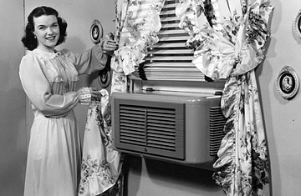
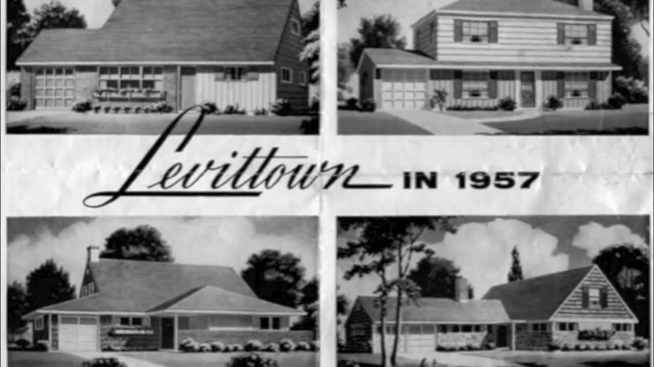
1930s and 40s: Post-War Boom
Air Conditioning units in homes
Population of the South increases
Baby Boom
1945-1980
Levittown
The first American subdivision
Radios in most homes
TVs in many homes
Americans want their news

Slide 3
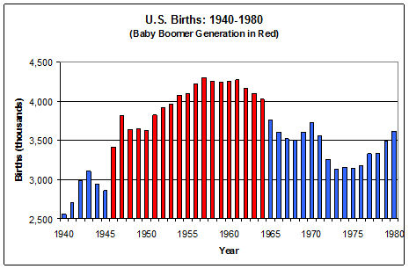

Slide 4
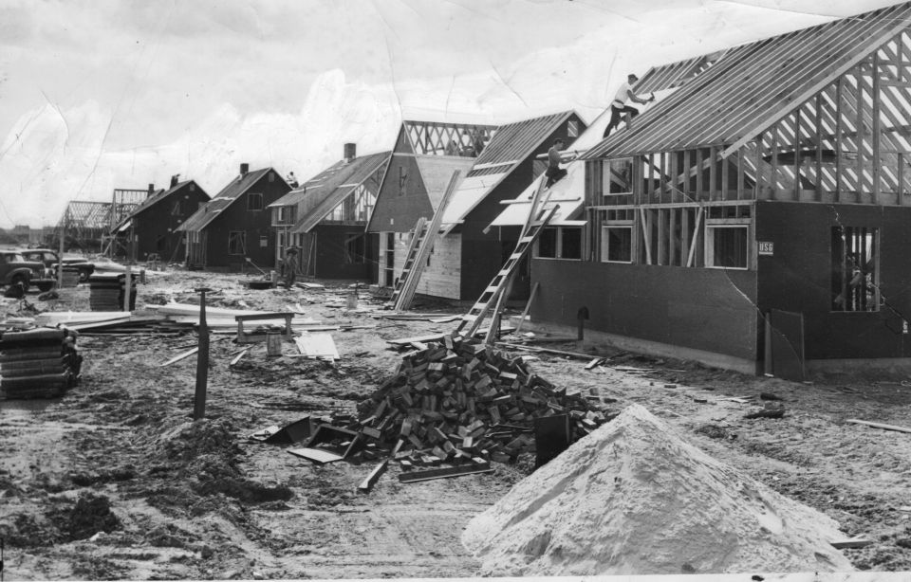

Slide 5
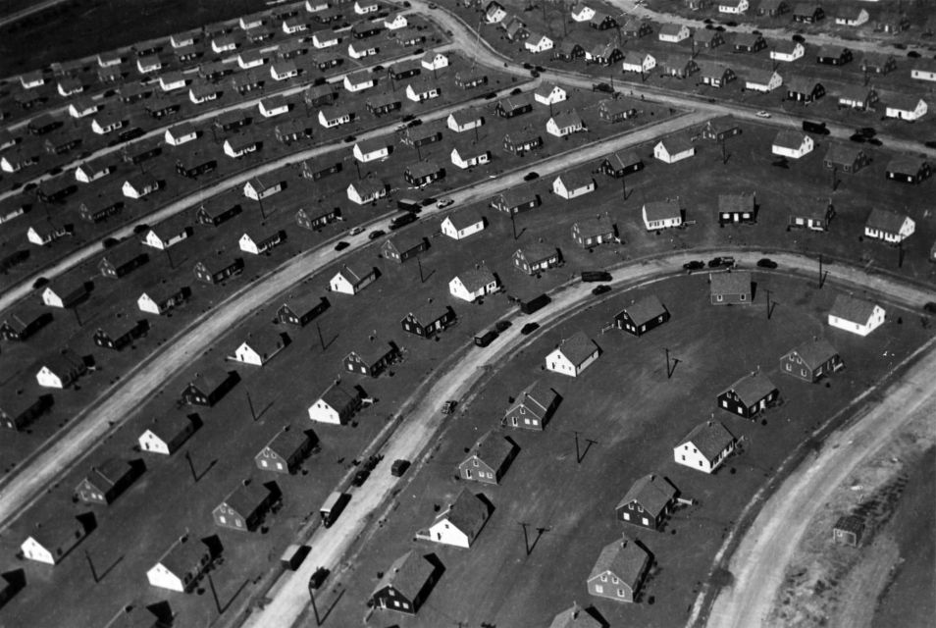

Slide 6
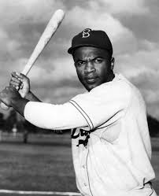
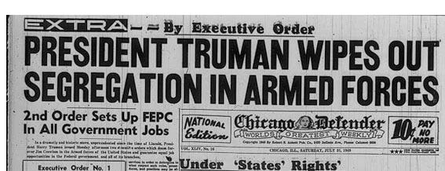
1930s and 40s: Post-War Boom
Jackie Robinson & MLB
Truman integrates the US military
Had been black regiments and white regiments
https://www.youtube.com/watch?v=NZ1RfJLayMk

Slide 7
The Truman Doctrine
Proposed by President Harry Truman in 1947, The Truman Doctrine provided aid to any country battling. communist aggression.
It was immediately used to support the free governments in Turkey and Greece against communist threats.

Slide 8
The Marshall Plan
The Marshall Plan
American initiative to aid Western Europe, in which the United States gave over $13 billion (approximately $132 billion in current dollar value as of October 2017) in economic support to help rebuild Western European economies after the end of WWII.
Restore the European economy to prevent the influence of Soviet Russia.

Slide 9
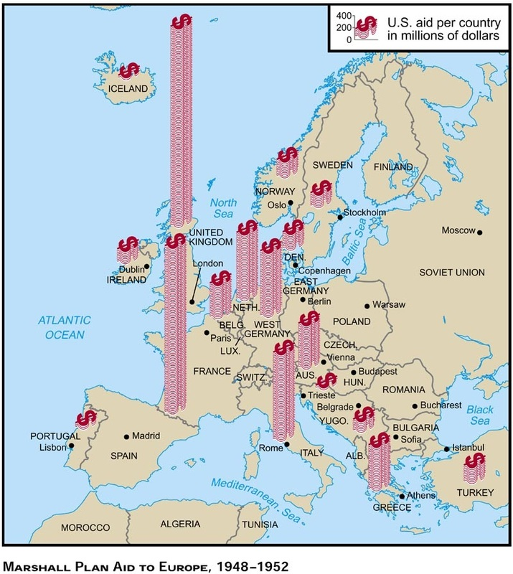

Slide 10
Containment (Truman)

Slide 14
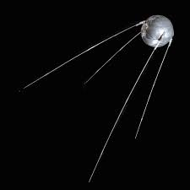
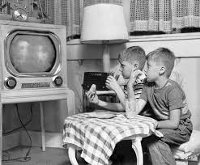
1950s: Cold War gets Hot https://www.youtube.com/watch?v=HpYCplyBknI
Cold War heats up
Churchhill states, “America at this moment, stands at the summit of the world.”
Continued fight against communism
Space Race
Sputnik
US encourages Math and Science education
Neil Armstrong walks on the moon
Brown v Board of Education
Continued civil rights conflicts
TVs in most homes
Rock and Roll baby!!!
https://www.youtube.com/watch?v=gj0Rz-uP4Mk

