Slide 1
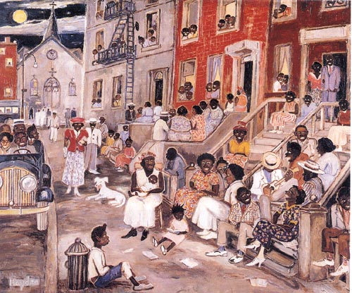
SSUSH16 The student will identify key developments in the aftermath of WW I.

Slide 2
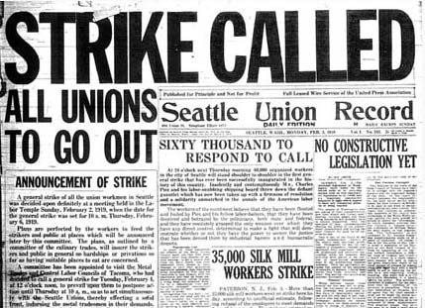
a. Explain how rising communism and socialism in the United States led to the Red Scare and immigrant restriction.
The mayor of Seattle felt that strikers wanted to “take possession of our American government and try to duplicate the anarchy of Russia”
The number of Labor Unions rose during WW I
Unions began using strikes as a means of trying to gain better working conditions
Strikes were associated with Communist led protests in Europe and worried many Americans that Communism would spread to the U.S.

Slide 3
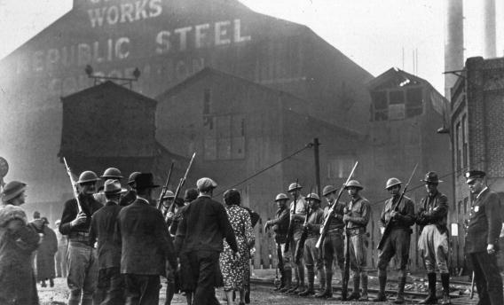
350,000 steel workers went on strike in 1919.
The head of U.S. Steel blamed the unrest on foreign radicals and broke the strike by hiring African Americans and Mexicans to work.

Slide 4
The Red Scare
Red Scare: The fear that communism was making its way into the United States through government employees, Hollywood actors, and union employees.
Numerous strikes in 1919 led many Americans to believe that the Communists were trying to start a revolution in the U.S.
The Communists were blamed for sending bombs through the postal system as a way of disrupting the American way of life
As a way of limiting “radicals” Congress passed laws limiting foreign immigration to the U.S.

Slide 5
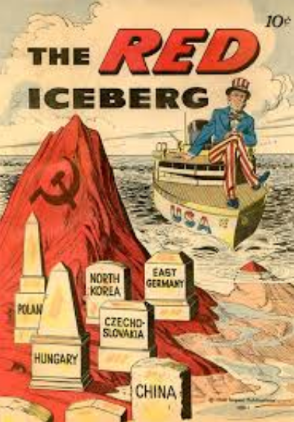
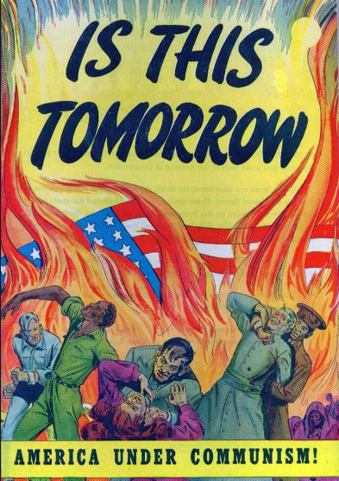

Slide 6
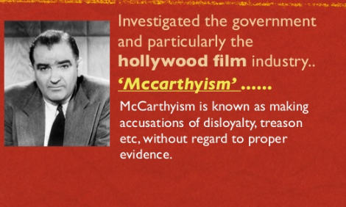
The Red Scare: Mccarthyism
Senator Joseph McCarthy
Suspicious of communist sympathizers in US Gov’t
Spends 5 years on a communist “witch hunt.”
His accusations were so strong that few spoke out against him

Slide 7
“Red” and communism today
During and after the Red Scare, the color red is often associated with communist countries.

Slide 8
Changes in the early 1900s
Red Scare
Radio and television
Continued growth in industry
Henry Ford
Assembly Line
Model T
African American interest in the arts
Harlem Renaissance

Slide 9
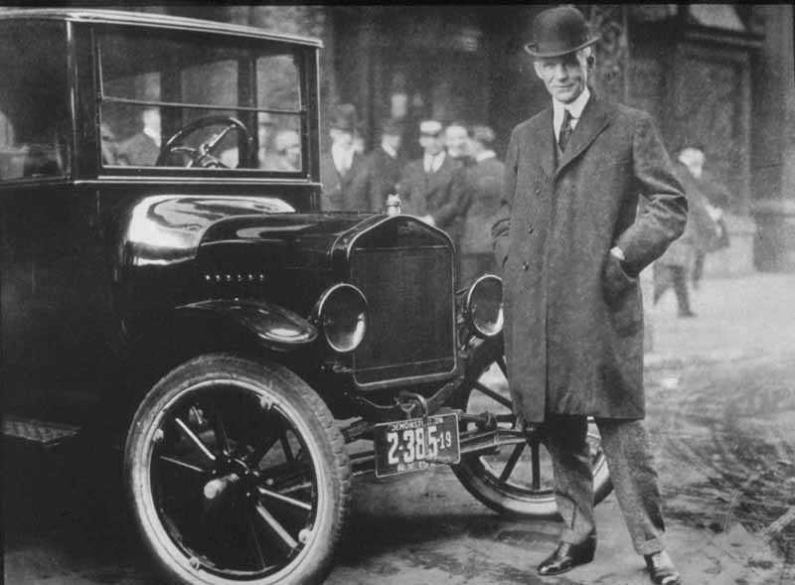
Henry Ford
1n 1908 Henry Ford began to mass produce cars, automobiles that the “everyday” man could afford.
He paid his workers $5 a day and sold his original Model “T” for $825.

Slide 10
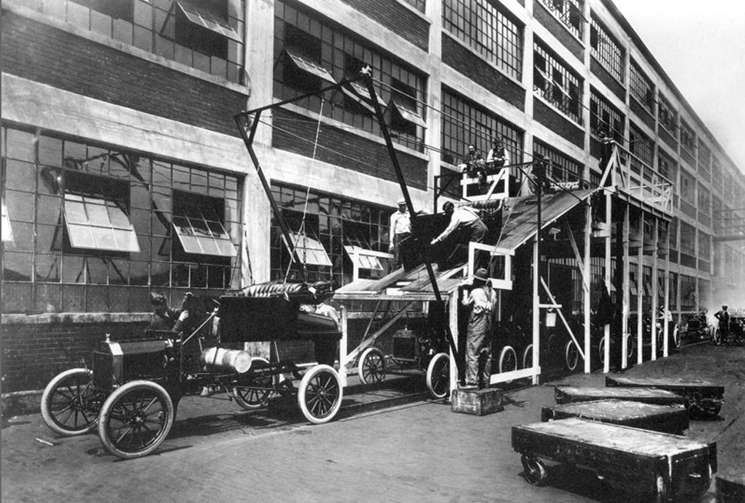
b. Identify Henry Ford, mass production, and the automobile.

Slide 11
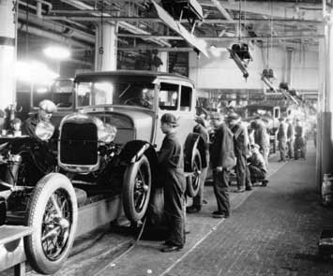
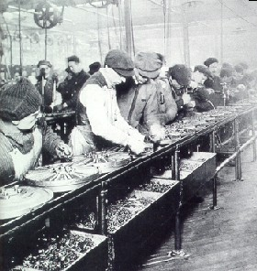
Henry Ford and Industry
Ford used the idea of mass production to build his cars on an assembly line.
Each worker had a specific job to do, which helped speed up the building process, reducing the cost of automobiles.

Slide 12
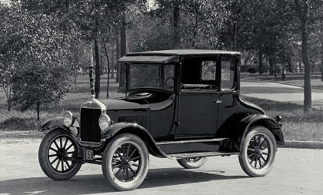
The automobile changed how Americans lived, allowing them to travel greater distances much quicker
The automobile industry also created growth in other industries such as the rubber, glass, and lead industries.

Slide 13
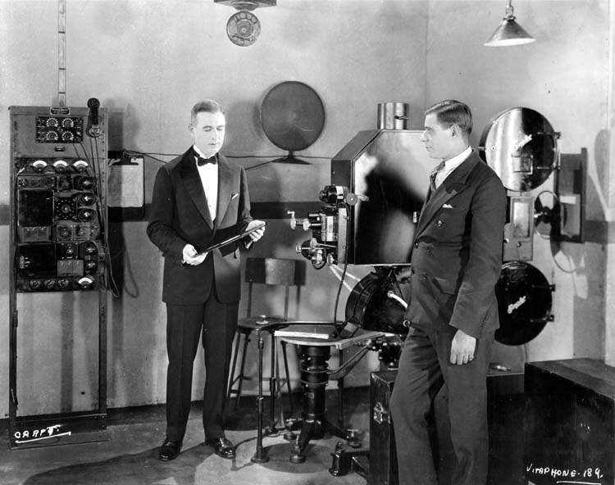
c. Describe the impact of radio and the movies on American life

Slide 14
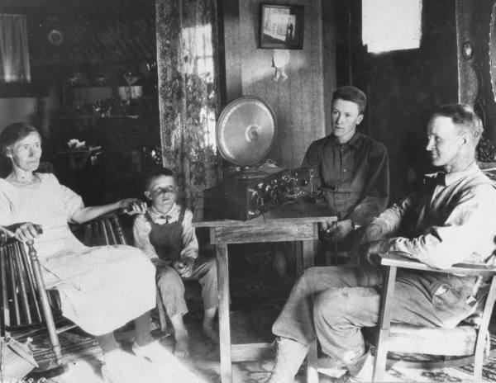
Impact of the Radio
Radio companies such as CBS and NBC were formed in the 1920s.
Radio allowed listeners to hear instant news of events and was a way for families to come together to listen to broadcasts.
Movies in the 1920s helped show “modern” lifestyles to Americans

Slide 15
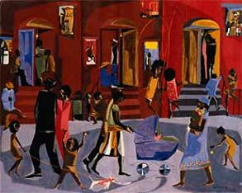
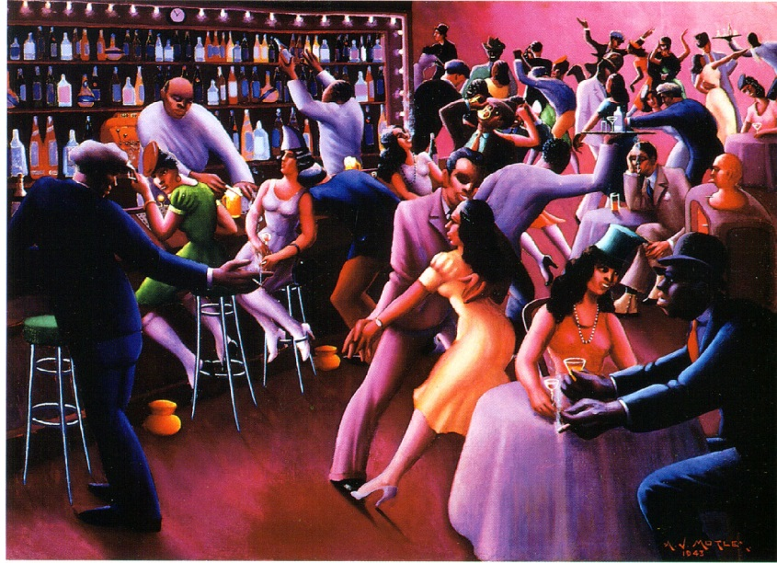
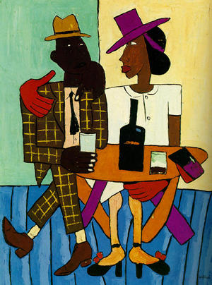
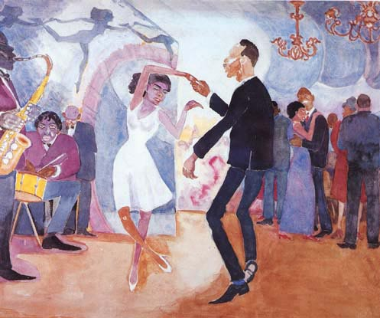
d. Describe modern forms of cultural expression; include Louis Armstrong and the origins of jazz, Langston Hughes and the Harlem Renaissance, Irving Berlin, and Tin Pan Alley.

Slide 16
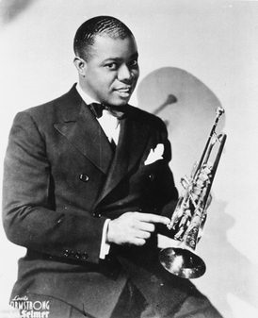
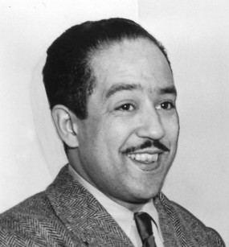
African American interest in the arts
Louis Armstrong
-Born in New Orleans and moved to Chicago in his 20s
-Played the cornet and trumpet and played an improvised form of Dixie Ragtime and jazz
-Influential in the New York jazz scene
Ain’tMisbehavin’: http://www.archive.org/details/Misbehavin
When the Saints Come Marching in: http://www.smithsonianjazz.org/class/armstrong/la/la_whenthesaints.mp3
Langston Hughes
-Born in Mississippi
-Wrote poems describing the disenfranchisement of many African Americans
For one of just a few known recordings of Langston Hughes click on the link below.
http://www.folkways.si.edu/listen2.aspx?type=preview&trackid=22357

Slide 17
Langston Hughes
I, Too, Sing America
I am the darker brother.
They send me to eat in the kitchen
When company comes,
But I laugh,
And eat well,
And grow strong.
Tomorrow,
I'll be at the table
When company comes.
Nobody'll dare
Say to me,
"Eat in the kitchen,"
Then.
Besides,
They'll see how beautiful I am
And be ashamed–
I, too, am America.
To hear Langston Hughes read I, Too click on the following link and click on the tab in red: http://www.poetryarchive.org/poetryarchive/singlePoet.do?poetId=1551
Life is Fine
I went down to the river,
I set down on the bank.
I tried to think but couldn't,
So I jumped in and sank.
I came up once and hollered!
I came up twice and cried!
If that water hadn't a-been so cold
I might've sunk and died.
Though you may hear me holler,
And you may see me cry–
I'll be dogged, sweet baby,
If you gonna see me die.
Life is fine! Fine as wine! Life is fine!

Slide 18
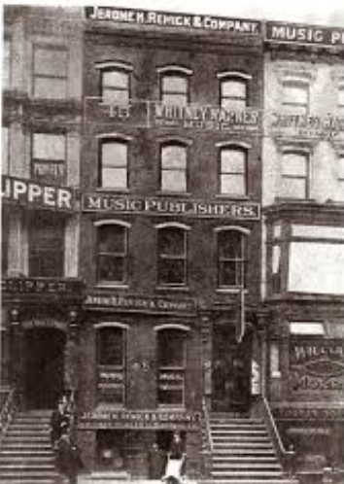
Tin Pan Alley
Tin Pan Alley was the name given to New York City’s songwriters and music publishers during the 1920s
One of the most famous writers was Irving Berlin, who wrote such songs as “God Bless America”, “White Christmas”, and “Alexander’s Ragtime Band”
Listen to some samples:
-Alexander’s Ragtime Band: http://www.archive.org/details/EDIS-SRP-0194-15
-White Christmas: http://www.archive.org/details/CaelaHarrisonWhiteChristmas

