Slide 1
Turing into the 20th century!

Slide 2
SSUSH14:a. Explain the Chinese Exclusion Act of 1882

Slide 3
Reasons for Anti-Immigration Stance
Economic depression on the west Coast!
Fierce job competition in the West cause by a surplus of low-paid Chinese labor
Employers where only hiring Chinese workers.
American’s began to resent the Chinese workers…

Slide 4
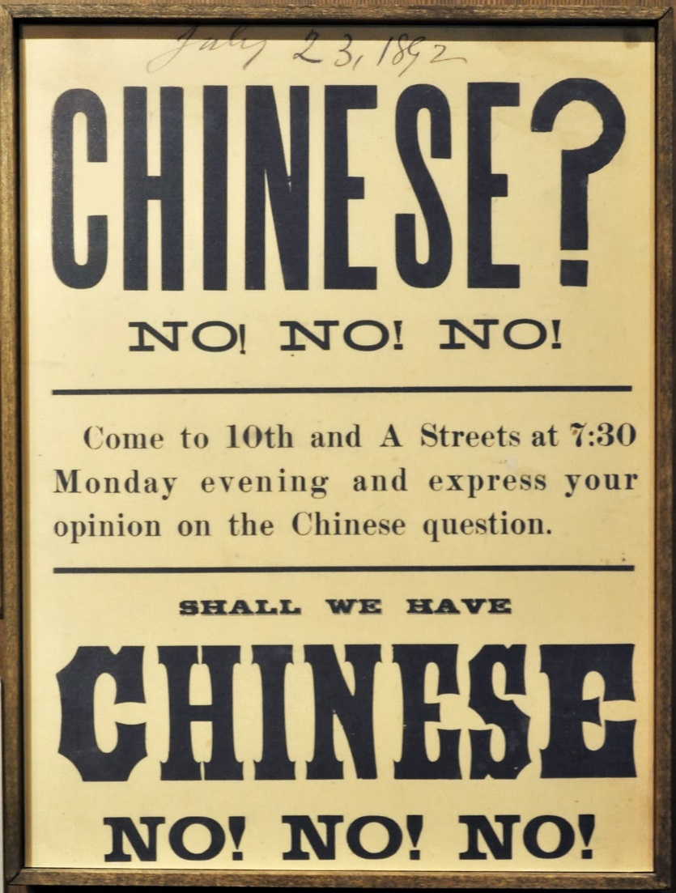
Chinese Exclusion Act
Prohibited further immigration from China for ten years. Eventually, the act was extended and remained in effect until 1943.

Slide 5
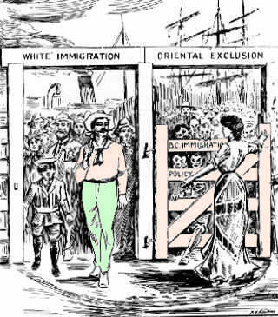
What does the cartoon show you about US immigration policies during the beginning of the 1900’s?

Slide 6
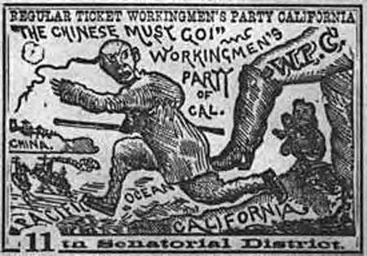

Slide 7
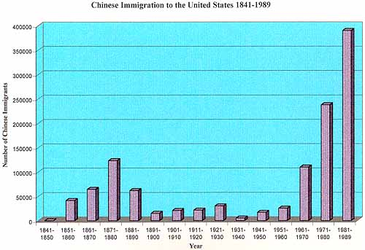

Slide 8
. 14: b. Describe the Spanish-American War

Slide 9
Spanish American War (1898)
In 1895 Jose’ Marti (Cuba) started another revolution against Spain. Spain responded by sending in Valeriano Weyler, who put nearly 300,000 Cubans in concentration camps.
U.S. helps Cuba – Causes of War
Yellow Journalism - exaggerating or stretching the truth.
Sinking of the USS Maine – U.S. battleship explodes while sitting in the harbor of Habana, Cuba. U.S. blames Spain.
Wanted to remove European influence from Western Hemisphere
April 1898 U.S. declares war on Spain

Slide 10
The USS Maine

Slide 11
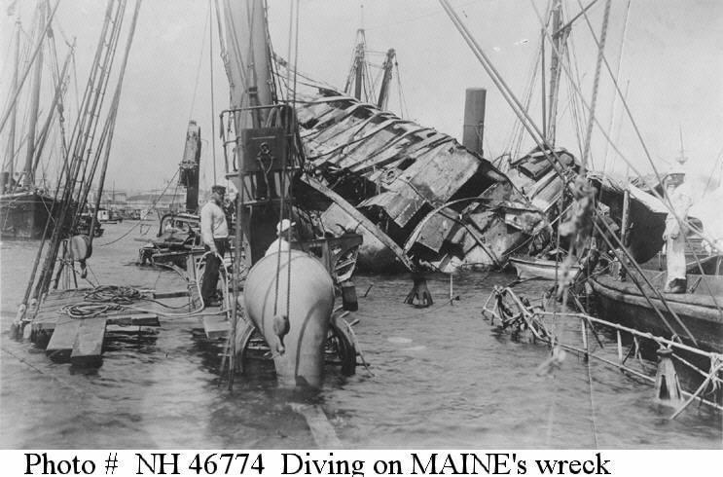

Slide 12
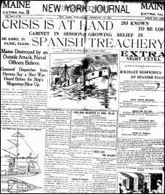
Yellow Journalism
An American term for journalism
that presents little or no legitimate well-researched news while instead using eye-catching headlines for increased sales

Slide 13
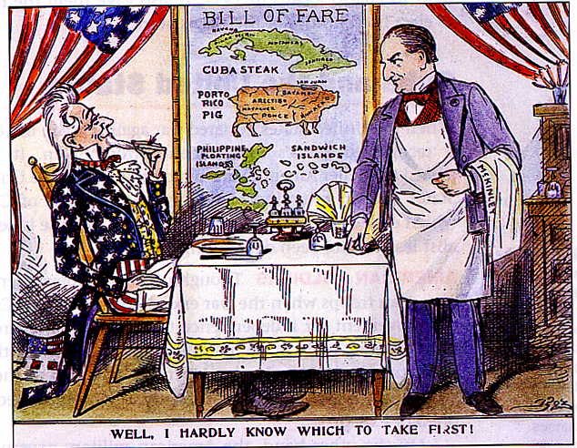
American Expansionism

Slide 14
SSUSH14: C. Explain U.S. involvement in Latin America

Slide 15
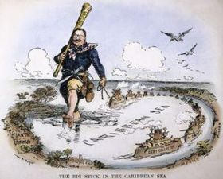
Roosevelt Corollary
European powers were getting involved in Latin America
Teddy Roosevelt wanted US to be the most powerful influence in Latin American.
“Speak softly and carry a big stick” policy
The Roosevelt Corollary stated: the U.S. would use force to protect its economic interests in Latin America

Slide 16
SSUSH14: C. The creation of the Panama Canal

Slide 17
Panama Canal
Panama Canal - A canal built by the U.S. cutting across Central America to reduce travel time and provide a short cut between the oceans for commercial and military ships.
U.S. chose Panama for the canal, which belonged to Colombia. They refused our offer…wanted more $.
US helps Panama rebel against Colombia
Panama accepts our offer ($10m and $250,000 a year)
Canal built between 1904-1914

Slide 22
Panama Canal:
The US aided its construction after recognizing Panama’s independence.
The Canal was built to serve the US military, political, and economic interest by allowing ships to travel back and fourth between the Pacific and Atlantic

Slide 23
